Slide 1

BIGDATA TECHNOLOGY
FINAL PROJECT
Students:
Duong Kha Nguyen
Duc Phuoc Doan
Duy Hanh Nguyen

Slide 2
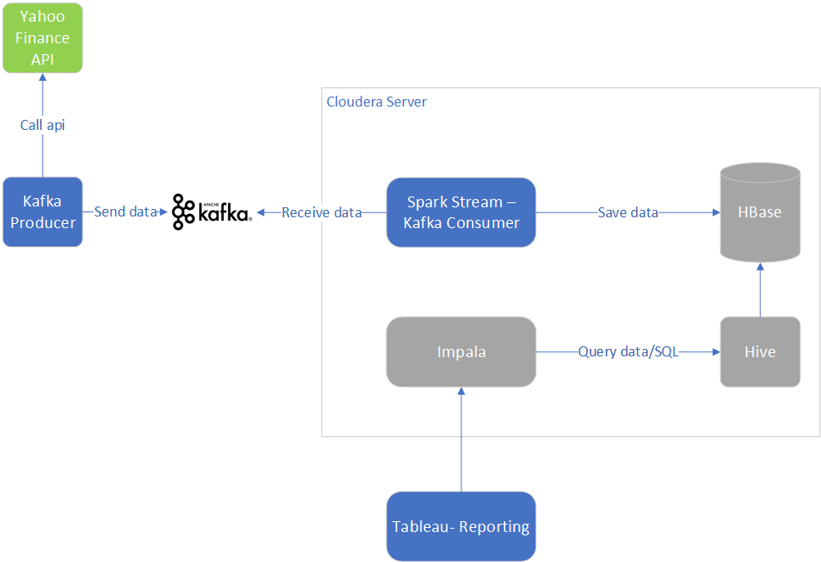
APPLICATION ARCHITECTURE

Slide 3
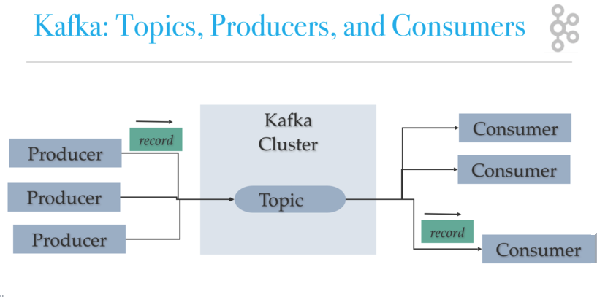
Apache Kafka

Slide 4
Start Kafka
Start zookeeper server:bin/zookeeper-server-start.sh config/zookeeper.properties
1
Start kafka server:bin/kafka-server-start.sh config/server.properties
2
Create topic: bin/kafka-topics.sh --create --zookeeper localhost:2181 --replication-factor 1 --partitions 1 --topic livestocks
3

Slide 5
Yahoo Finance Producer
API: https://query1.finance.yahoo.com/v7/finance/quote?lang=en-US&region=US&corsDomain=finance.yahoo.com
Send to Kafka: producer.send(new ProducerRecord<String, String>(topic, hashMap.get("fields"), value));
Configurable
Start producer: java -jar YahooFinance.jar conf.properties

Slide 6
Spark Stream – Kafka Consumer
Receive data from Kafka : Input Stream - DStream (Discretized Stream)
Parsing data for saving : RDD(Resilient Distributed Datasets )
Spark SQL: query data for showing in console
Create HBase tables : live_stock and history_stock
Start consumer: spark-submit --class "cs523.StockSparkStream.KafkaStockStream" --master yarn Desktop/StockSparkStream.jar kafka_zk_ipaddress hbase_zk_ipaddress <topic>

Slide 7
Tableau - Reporting
Hive tables: im_live_stock, im_history_stock
Hive views:v_im_live_stock,v_im_history_stock
Tableau: SQL query for data via Impala

Slide 8
Q&A
THANK YOU

